Slide 1
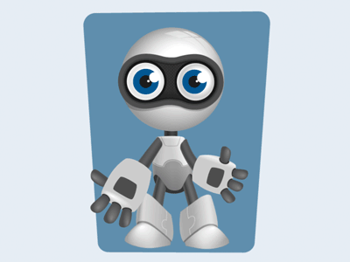
Welcome to Robotics
Where we fiddle with stuff...
in order to build stuff...
and learn stuff along the way.
2024
Edition!

Slide 2
Code of Conduct
A+
Come to class
Ready to fiddle, fail, try again
Ready to learn new things
Looking to apply your strengths
Respect each others ideas
No studying for other classes during Robotics
No internet use
No phones or smart watches

Slide 3
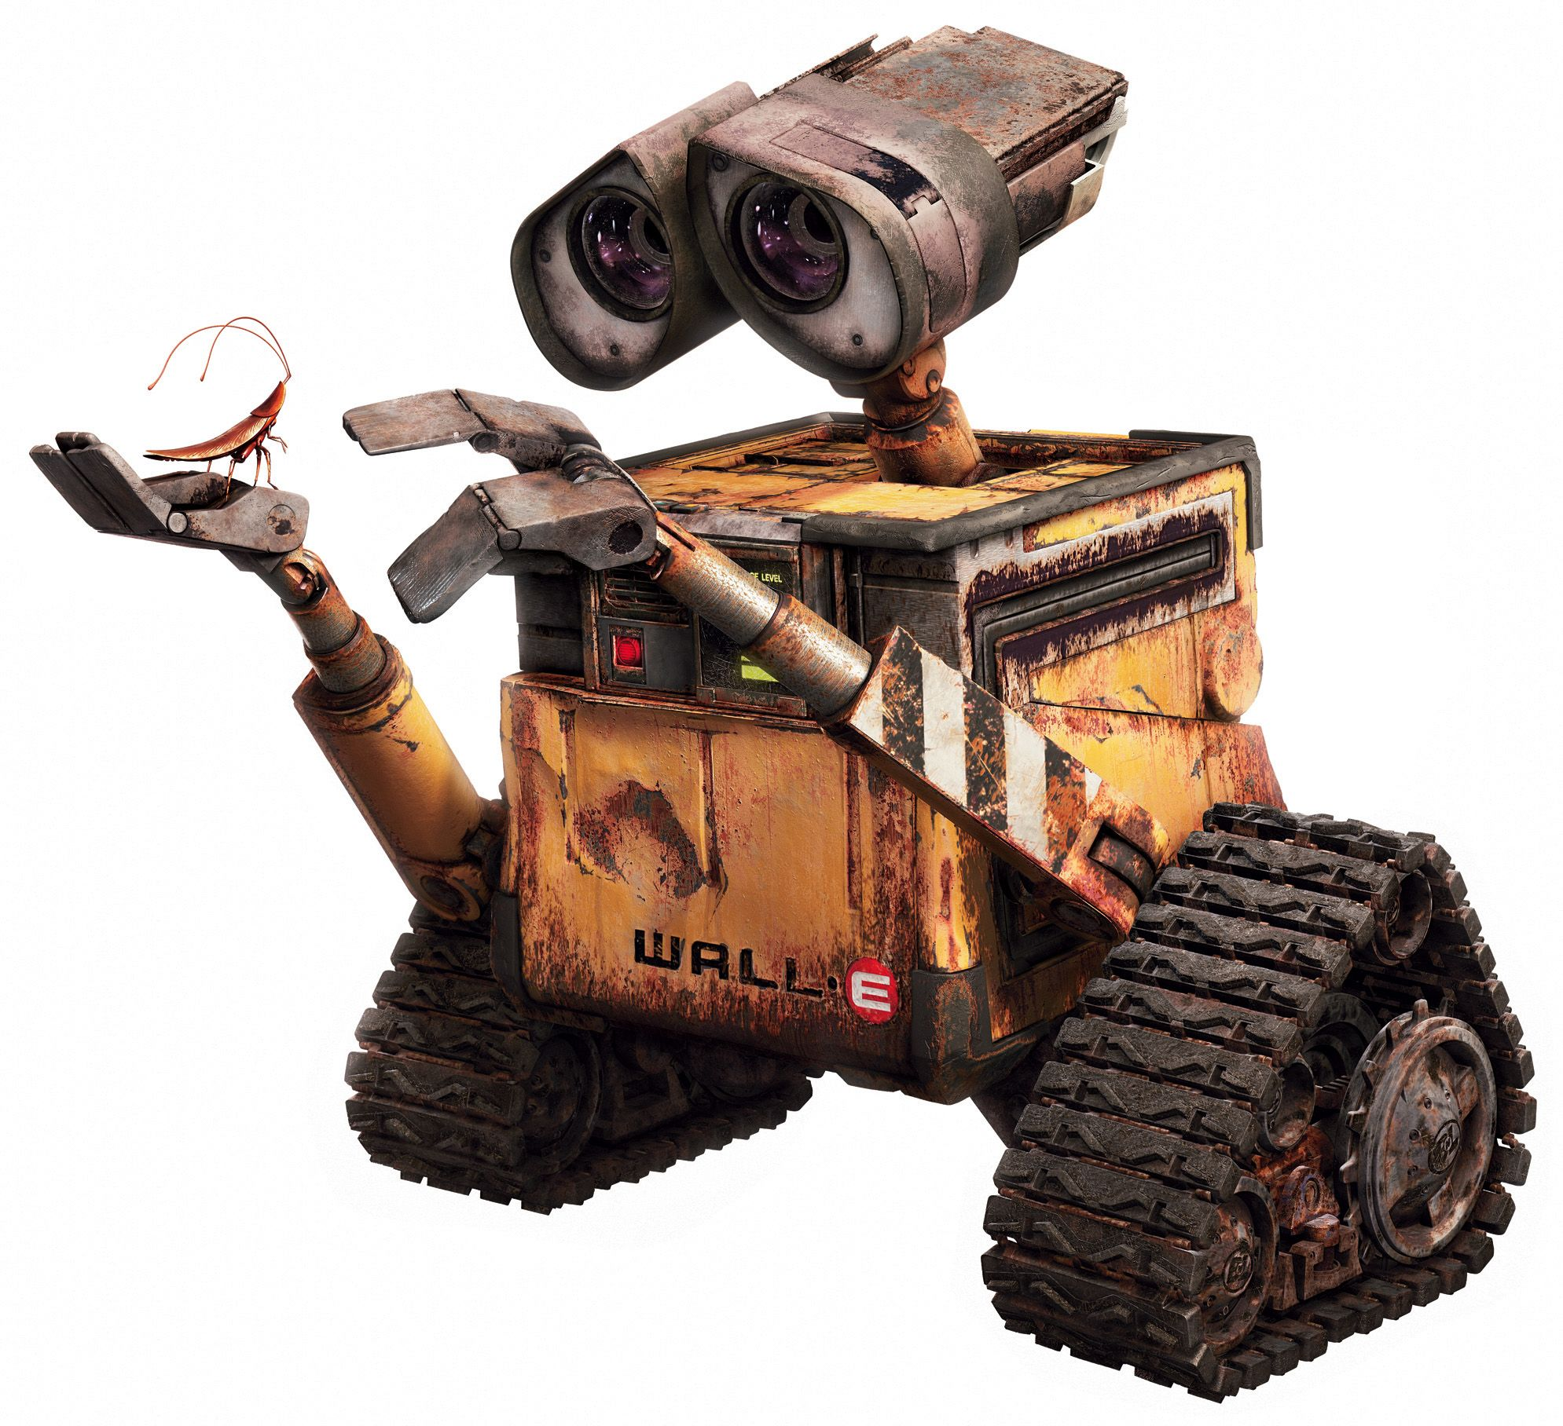
Robots Perform
Their Own Tasks

Slide 4
Electronics
Mechanics
Software
Robotics Combines All of These Disciplines
Notes:
Robotics is a discipline: engineering + computer science.
The goal of robotics: design machines that operate autonomously to perform a complex task that humans normally do. The robot should be able to help & assist the human.

Slide 5
Where are robots used & why?

Slide 6
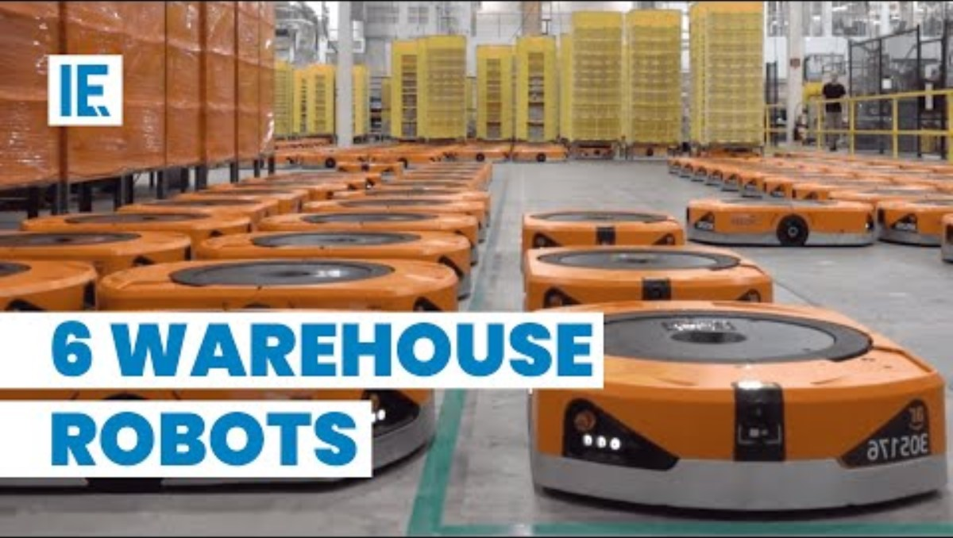

Slide 7
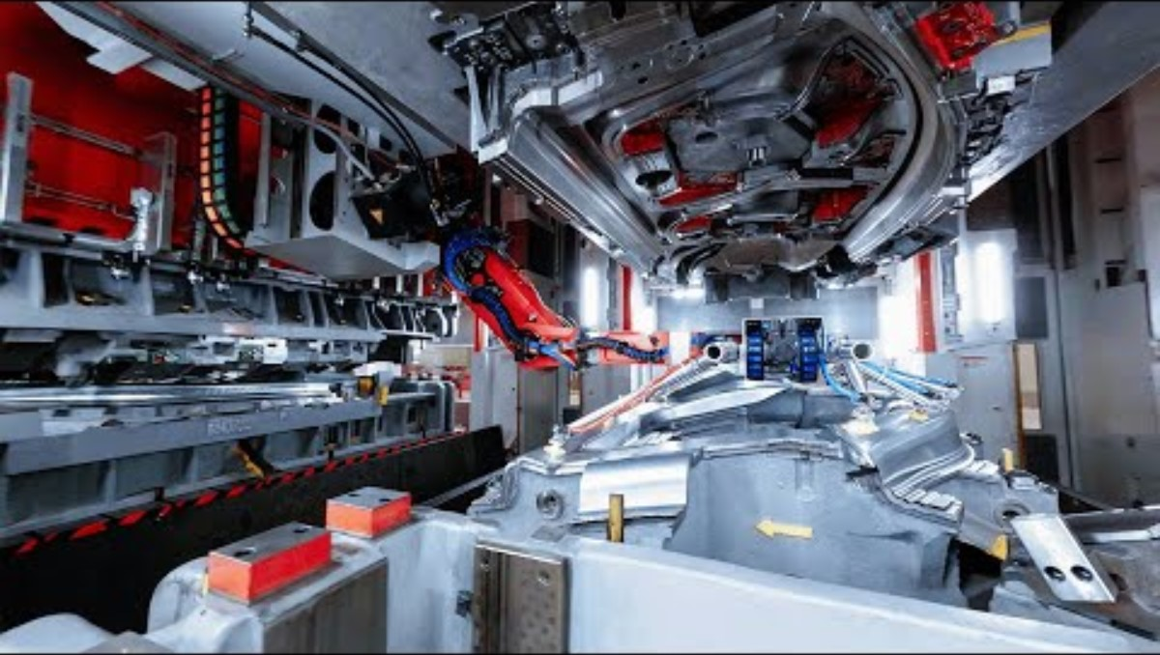
Tesla Plant Video – So Many Robots!

Slide 8
Course Syllabus: Manufacturing Robots
Modules
Along The Way
Manufacturing: Basic Robotic Concepts
Coordinated Complexity
Machine Learning
Raspberry Pi
Hardware Integration: Lego + Raspberry Pi
Final Challenge
2 Papers – don’t stress!
Down time happens. We’ll have fun together
Being social is expected. Talk to each other!

